Slide 1
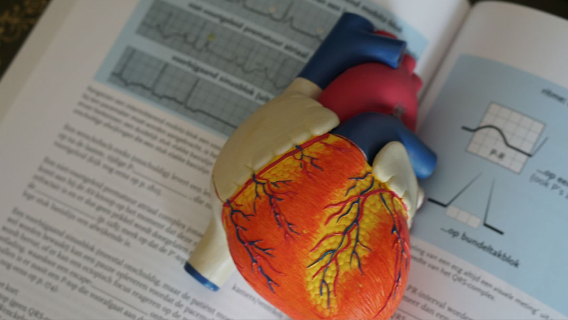
TOPIC: Advanced Predictive
Modelling in Healthcare
Data Analytics for Early
Disease Detection and
Proactive Medical
Intervention
EAS508
Statistics and Data Mining - I

Slide 2
Group 2
MEMBERS
Gaurav Kumar Jha (UB #50534318)
Abhinav Nehra (UB #50539727)
Kumar Utkarsh (UB #50540352)
AISHWARYA NAYAK(UB #50453772)

Slide 3
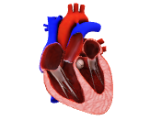
Objective

Slide 4
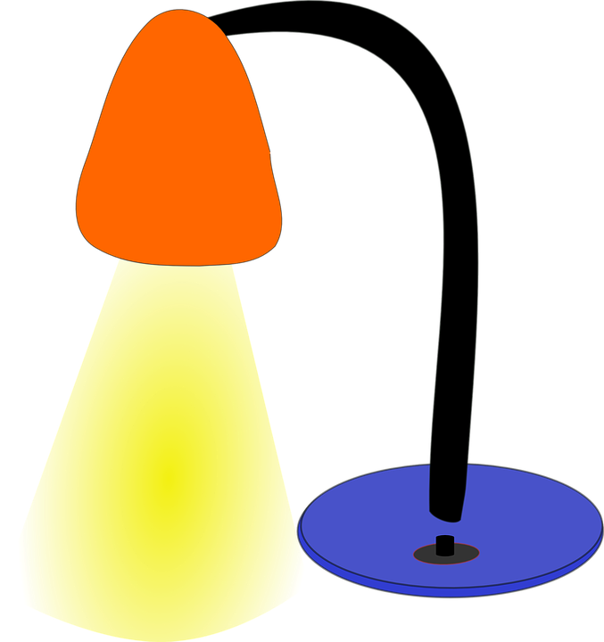
Objective
We focus on early detection of cardiovascular diseases to improve patient outcomes and reduce healthcare costs. Leveraging data mining techniques, we aim to build a model that predicts disease risk, integrating health metrics and lifestyle data. Join us as we explore how analytics can transform proactive healthcare.
The purpose of the project is to collectively apply the data mining techniques we have learnt so far to create a reliable prediction model.

Slide 5
Objective
Dataset overview

Slide 6

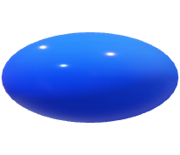


About the dataset
Categorical
columns
cp
fbs
restecg
exang
slope
gender
thal
Continuous
data columns
age
trestbps
chol
thalch
old peak
ca
Unique Id
columns
id
dataset
The “num” column in the dataset states the yes/no cases of heart attack in patients

Slide 7
Objective
Dataset overview
Data issues

Slide 8




Data issues/challenges
Missing data
Categorical features
Outlier
Irrelevant columns
NOTE: The dataset exhibits a 45:55 ratio of 'yes' to 'no' cases in the target variable. Hence, we have a balanced dataset.

Slide 9
Objective
Dataset overview
Data issues
Data mining

Slide 10
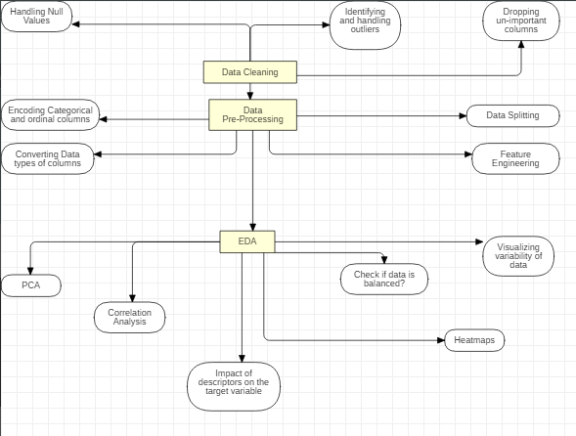
Data Mining Logic

Slide 11
Objective
Dataset overview
Data issues
Data mining
EDA

Slide 12
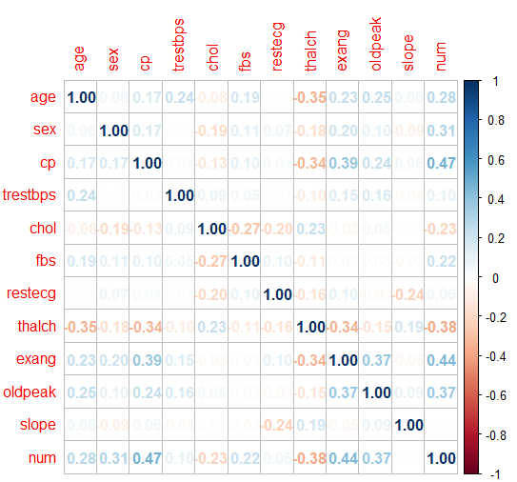
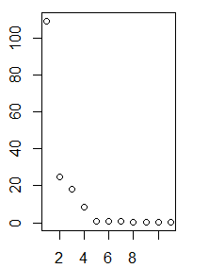
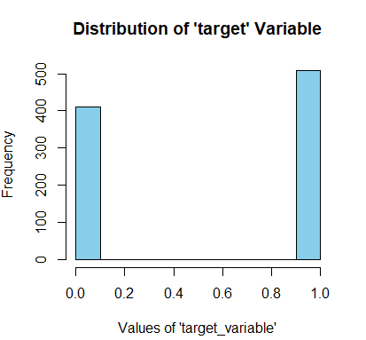
Exploratory Data Analysis (EDA)

Slide 13
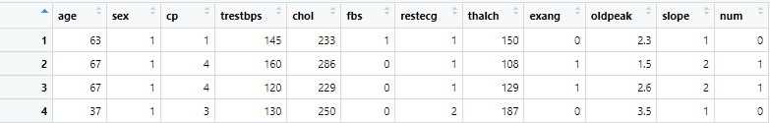
Data Before EDA
Data After EDA

Slide 14
Objective
Dataset overview
Data issues
Data mining
EDA
Model training results & conclusions

Slide 15

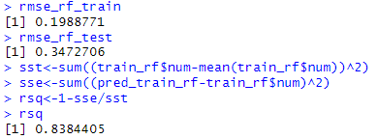
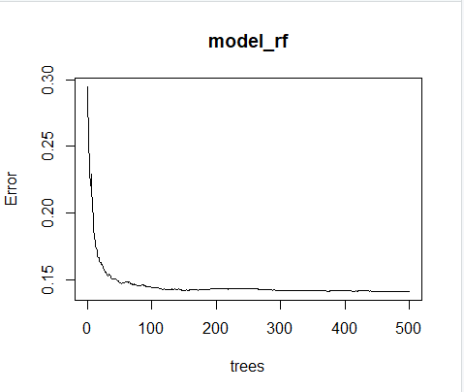
Model training
Random Forest
RMSE :
Training RMSE: 0.1988771
Test RMSE: 0.3472706
Lower RMSE values indicate better model performance. The training RMSE is lower than the test RMSE, which might suggest the model generalizes reasonably well to new, unseen data.
R-squared :
R-squared (RSQ): 0.8384405
RSQ represents the proportion of variance explained by the model. An RSQ closer to 1 indicates the model explains a larger portion of the variance. In this case, the model seems to capture about 83.8% of the variance, which is decent.
These metrics suggest that the model performs well, considering the relatively low RMSE values and a reasonably high R-squared value.

Slide 16
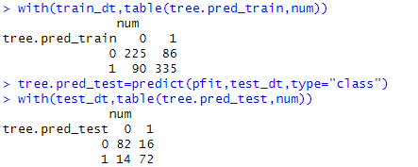
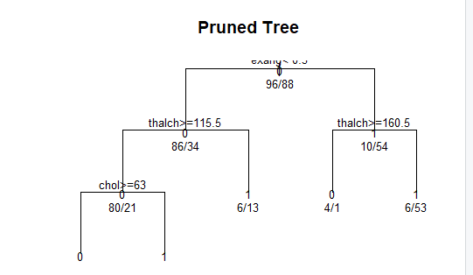
Decision tree
TRAINING ACCURACY:​
ACCURACY=(225+335)/(225+86+90+335)​
~=76.08%​
​
TESTING ACCURACY:​
ACCURACY~=83.70%​
​
THESE METRICS SUGGEST THAT THE MODEL PERFORMS WELL ON THE UNSEEN DATA WHICH MEANS IT IS GENERALIZING WELL WITH AN ACCURACY OF ~=83.7%​

Slide 17
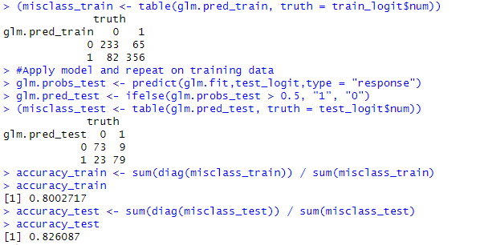
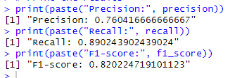
Logistic Regression
Precision: 0.76 (approximately 76% of the predicted positive cases were actually positive)
Recall: 0.89 (approximately 89% of the actual positive cases were predicted correctly)
F1-score: 0.82 (harmonic mean of precision and recall, a measure of a test's accuracy; higher values indicate better model performance)
These values suggest that LR model performs reasonably well in terms of identifying positive cases while keeping false positives relatively low.

Slide 18
Conclusion
Based on our observations, we think that Random forest model performs the best along with Logistic Regression followed by Decision Tree.
Summary:
Random Forest shows lower RMSE for the train data and a reasonably high R-squared, indicating good fit and predictive ability.
Decision Tree appears to perform moderately well in accuracy on the test data but might have room for improvement.
Logistic Regression exhibits good accuracy for both train and test data, showing consistent performance.
Recommendation:
Considering the overall metrics, Logistic Regression seems to perform slightly better based on accuracy metrics for both train and test data. However, if predictive power is more critical than interpretability, Random Forest with its higher R-squared and lower RMSE could be a preferred choice. Ultimately, the choice between these models depends on the specific goals of the project, such as the importance of interpretability, prediction accuracy, and computational complexity.

Slide 19
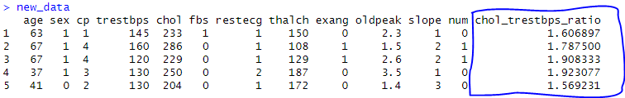
What Did We Do Differently
We tried Feature Engineering for this dataset, wherein we combined two columns into one by calculating Cholestrol to BP ratio and tried training the model to see if any improvement occurs.
There was no improvement in the prediction accuracy, this suggests that the created or modified features did not significantly contribute to improving the model's predictive power. Further exploration or alternative approaches might be necessary to uncover more meaningful features or relationships within the dataset.

Slide 20
Objective
Dataset overview
Data issues
Data mining
EDA
Model training results & conclusions
Future work

Slide 21
Future Work
Augment the Dataset
Enrich the existing dataset by integrating additional data from diverse sources to broaden the feature set. This expanded pool of descriptors aims to enhance the model's resilience and generalizability.
Feature-Engineering
Once we integrate this dataset with more descriptors, we can try feature engineering and see if we are able to generate a whole new descriptor which can improve our model's performance.
Integration with visualization tool
Explore the integration of this project with sophisticated visualization tools such as Tableau or Power BI. Leveraging these tools aims to offer more exhaustive and comprehensive visual representations, facilitating in-depth exploration of data.
Creation of a Front-End API
We can create a front-end API with frameworks like stream-lit or flask to integrate with this model and deploy it on any cloud platform to make the predictions accessible via APIs.

Slide 22
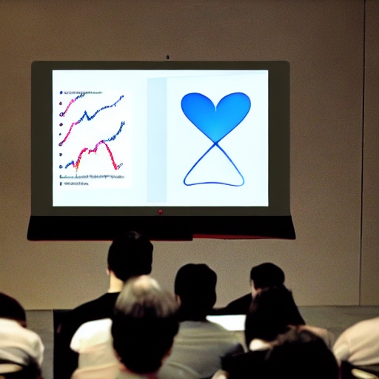
Q & A

